Slide 1



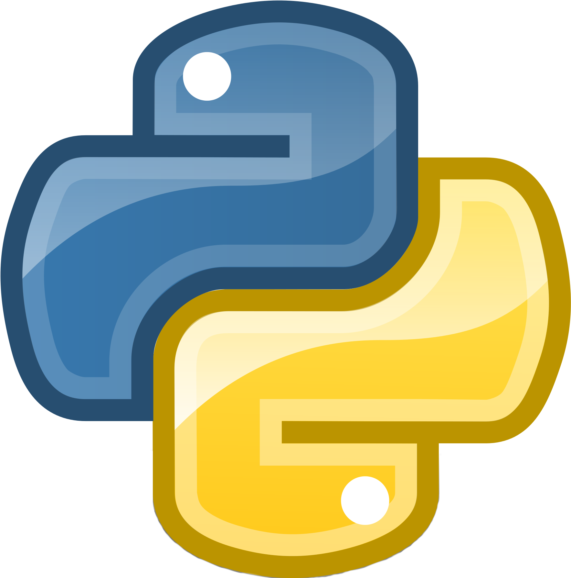



IoT Anomalies Detection

Slide 2







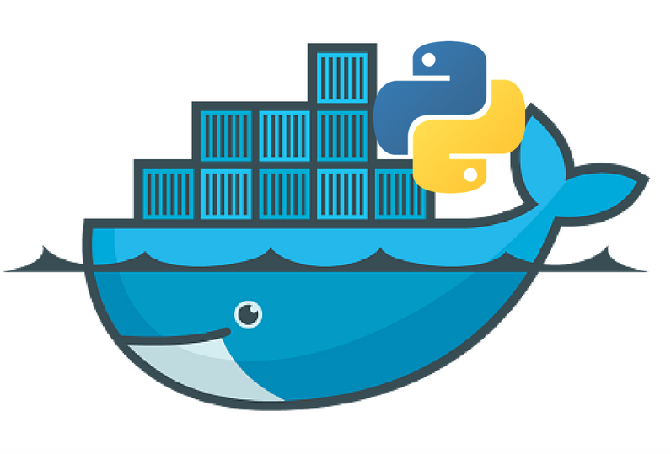
vercel.app
EC2
Packets Processing and AI Agent

